Slide 1
High Threshold Cerenkov Counter (HTCC) For CLAS12
Hakob Voskanyan
(AANL, Armenia)

Slide 2
Outline
• General Description
Parameters
Main Components
• Light Monitoring System
Components
Calibration

Slide 3
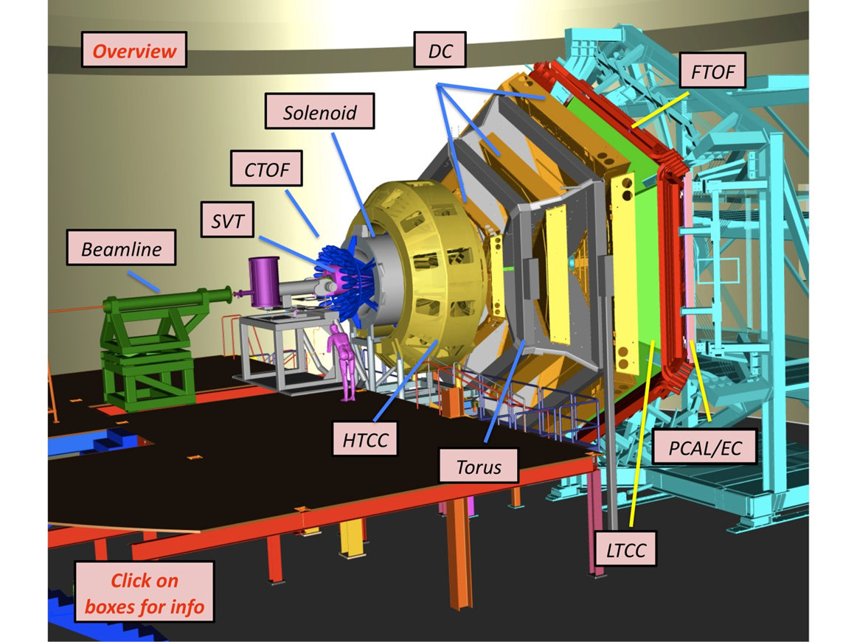
Clas12 Detector

Slide 4
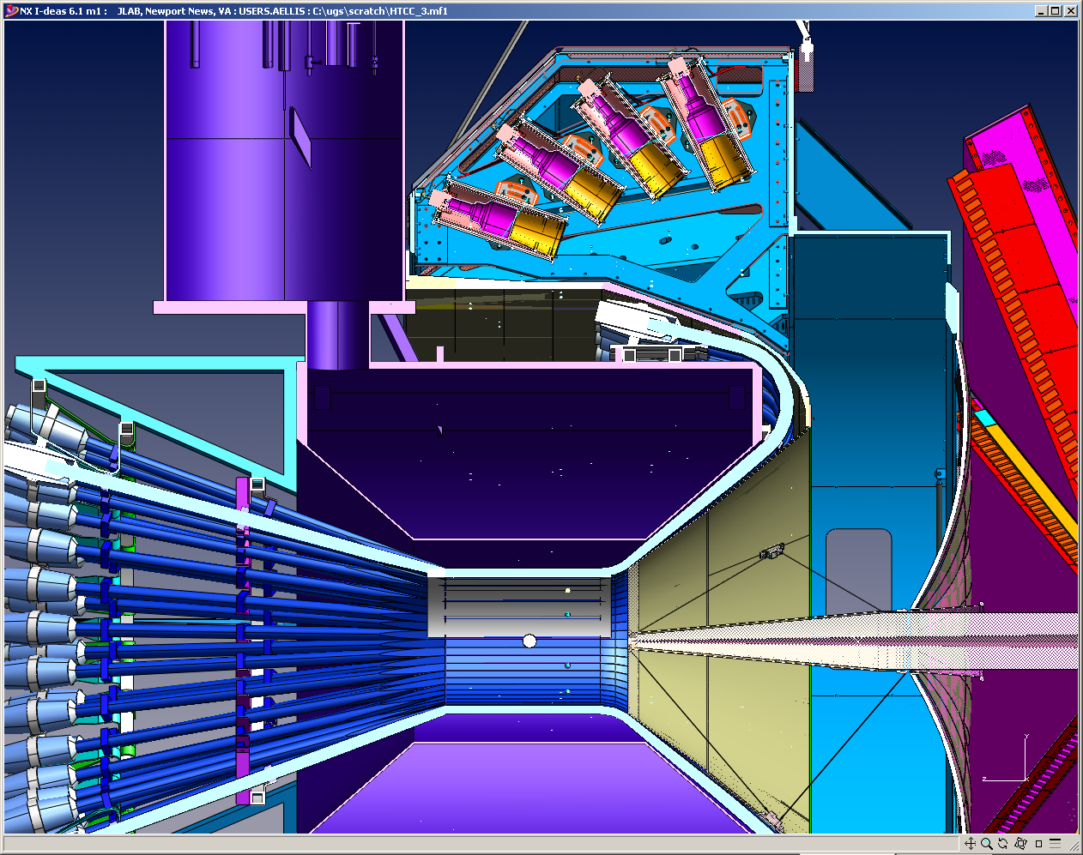
HTCC and Central Detectors

Slide 5
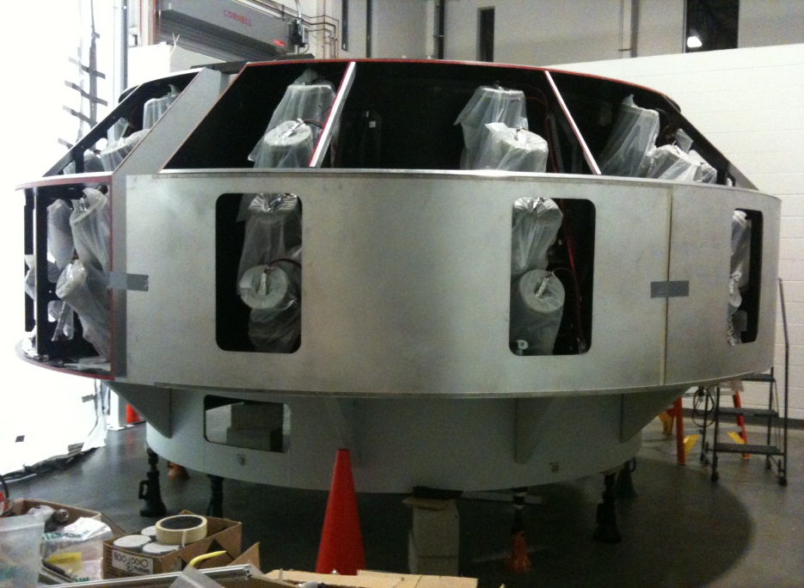
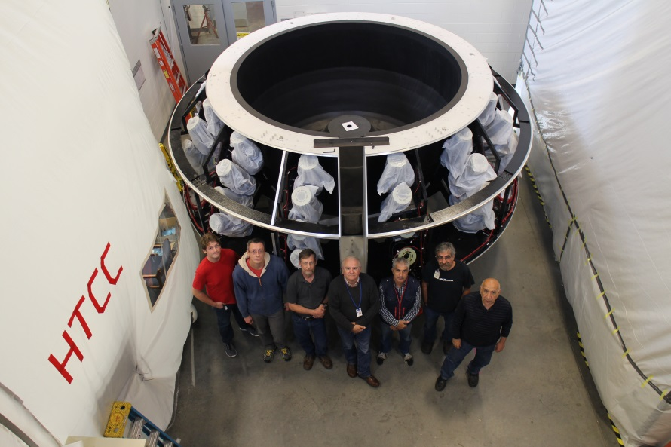
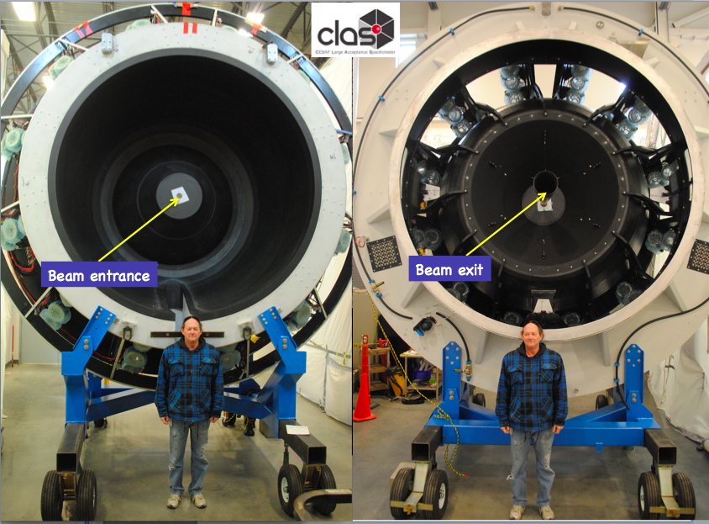
High Threshold Cerenkov Counter (HTCC) for CLAC12
HTCC

Slide 6
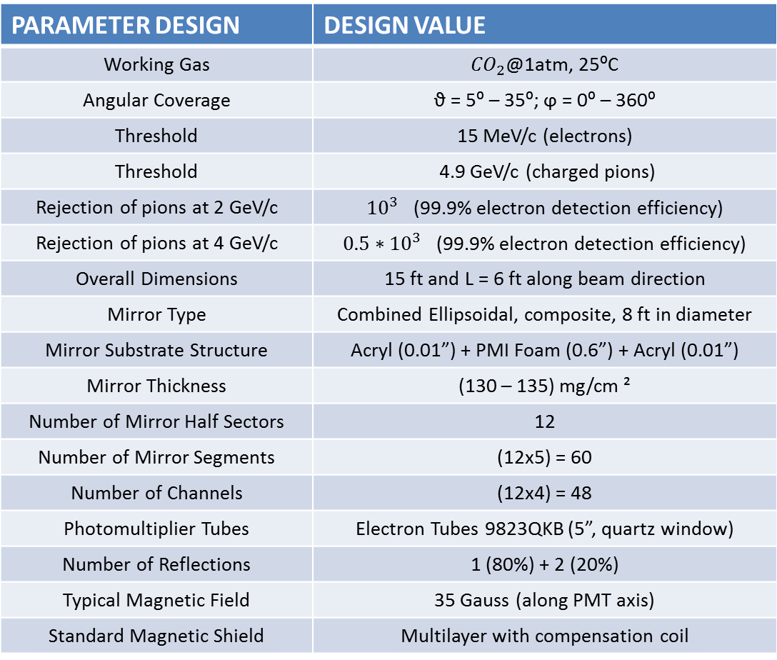
HTCC Parameters
PARAMETER DESIGN | DESIGN VALUE
Working Gas | ${CO}_{2}$@1atm, 25⁰C
Angular Coverage | ϑ = 5⁰ – 35⁰; ϕ = 0⁰ – 360⁰
Threshold | 15 MeV/c (electrons)
Threshold | 4.9 GeV/c (charged pions)
Rejection of pions at 2 GeV/c | ${10}^{3}$ (99.9% electron detection efficiency)
Rejection of pions at 4 GeV/c | ${0.5∗10}^{3}$ (99.9% electron detection efficiency)
Overall Dimensions | 15 ft and L = 6 ft along beam direction
Mirror Type | Combined Ellipsoidal, composite, 8 ft in diameter
Mirror Substrate Structure | Acryl (0.01”) + PMI Foam (0.6”) + Acryl (0.01”)
Mirror Thickness | (130 – 135) mg/cm ²
Number of Mirror Half Sectors | 12
Number of Mirror Segments | (12x5) = 60
Number of Channels | (12x4) = 48
Photomultiplier Tubes | Electron Tubes 9823QKB (5”, quartz window)
Number of Reflections | 1 (80%) + 2 (20%)
Typical Magnetic Field | 35 Gauss (along PMT axis)
Standard Magnetic Shield | Multilayer with compensation coil

Slide 7
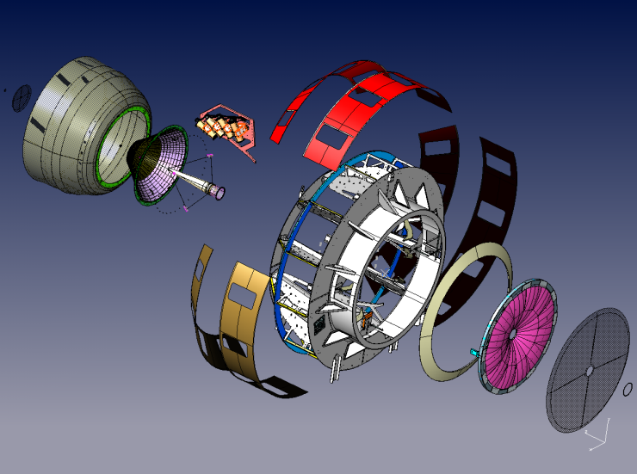
HTCC’s Main Components
1. COMPOSITE ENTRY WINDOW
2. ENTRY DISH
3. ENTRY CONE
4. MOLLER CUP
5. PMT HOUSING UNITS
PMTs and Winston Cones
Magnetic Shields
Compensation Coils
Modified HV-dividers
6. WELDEMENT PART
7. OUTER SHELLS
8. COMBINED MIRROR
9. EXIT WINDOW

Slide 8
High Threshold Cerenkov Counter (HTCC) for CLAC12
Main Components

Slide 9
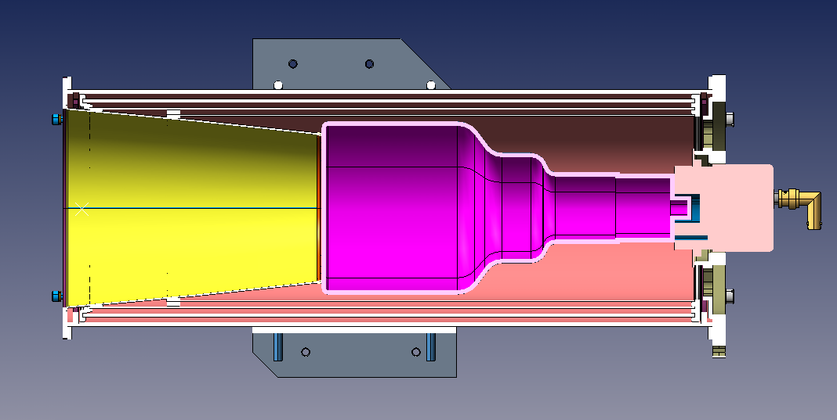
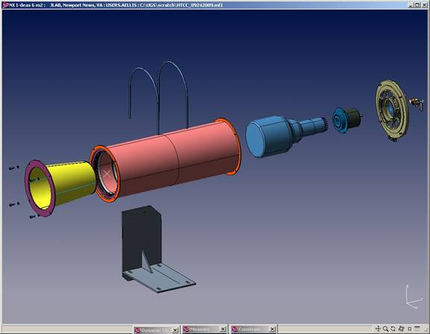
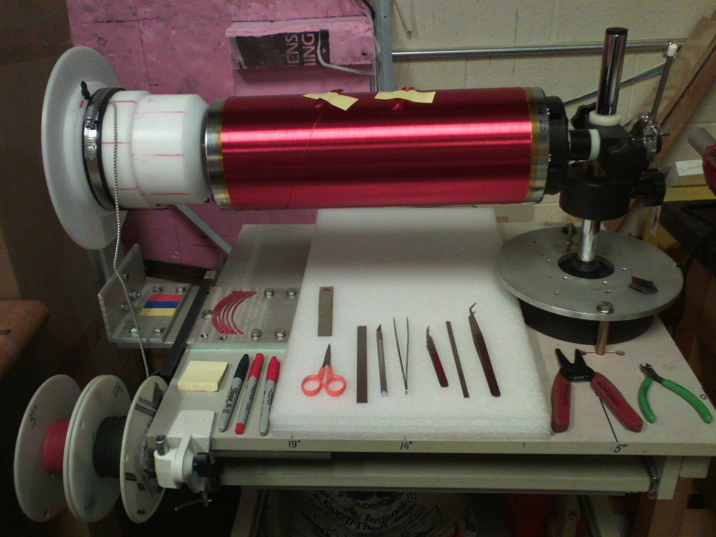
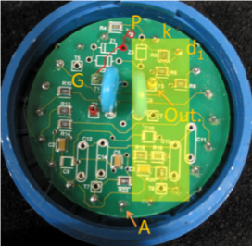
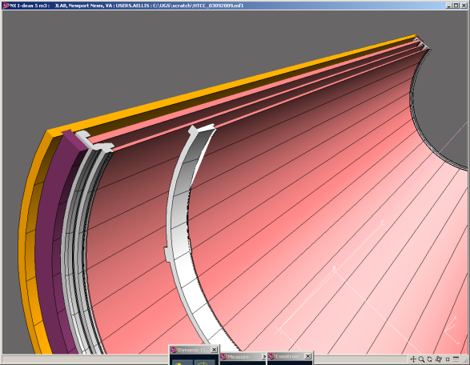
PMT HOUSING UNITS
PMT HOUSING UNITS
PMTs and Winston Cones
Magnetic Shields
Compensation Coils
Modified HV-dividers

Slide 10
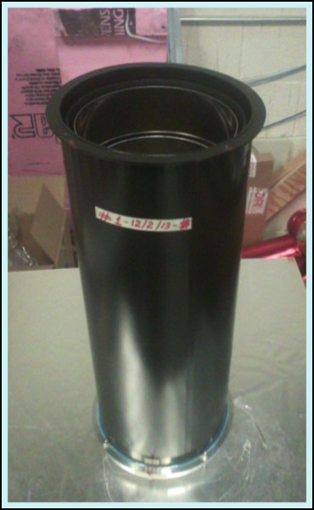
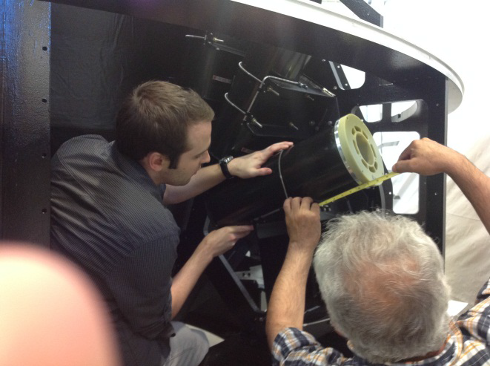
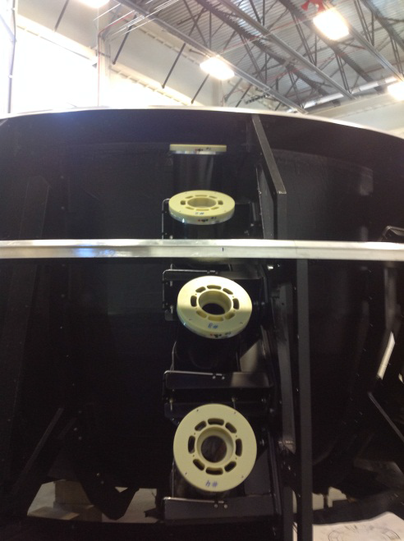
Installation of PMT Mounting Unit
Installation of first four Units
Installed Units
Assembled Unit

Slide 11
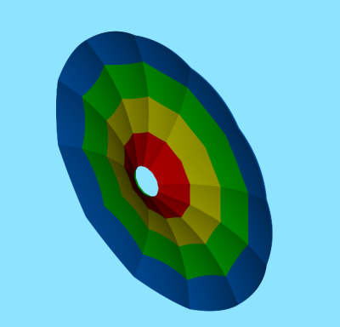
HTCC Combined Ellipsoidal Mirrors
The HTCC is a one unit detector with core component of Ellipsoidal Combined Mirror (consisting of 60 lightweight Ellipsoidal Mirror Facets).
Each sector of the CLAS12 is covered with 2 identical Half-sector Mirrors.
Mirror Thickness - (130 – 135) mg/cm²
Combined Ellipsoidal Mirror

Slide 12
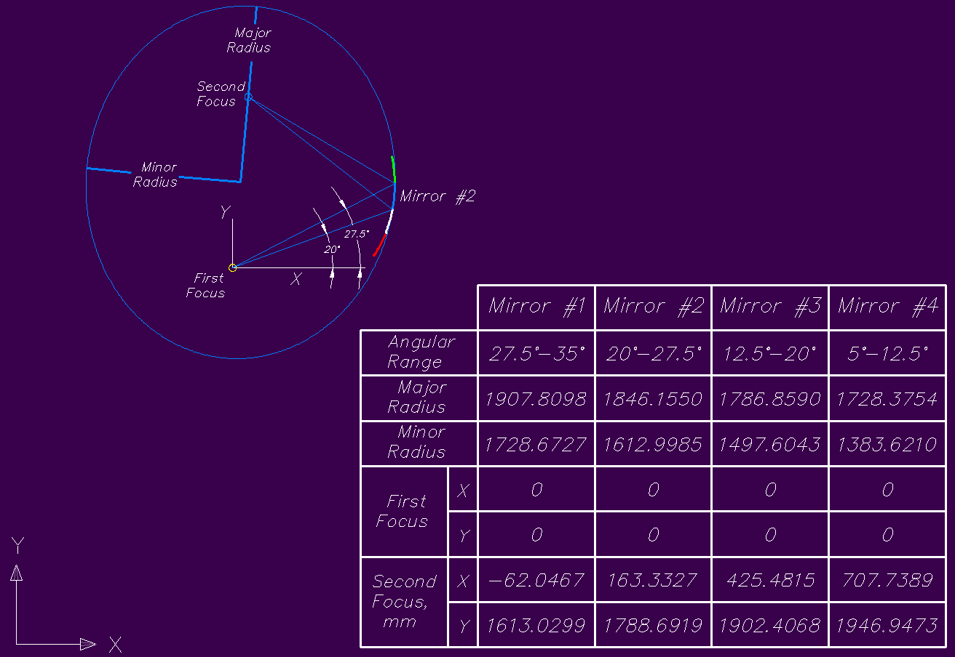
Geometry
The First focal point always corresponds to the target location, and the top focal point always corresponds to the PMT location

Slide 13
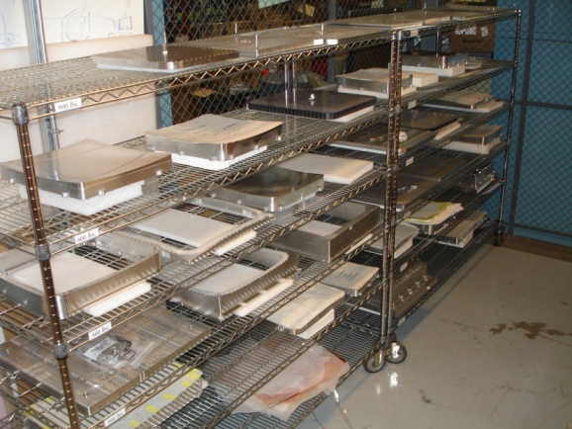
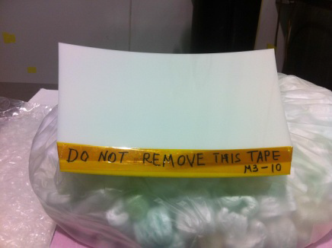
Mirrors construction
Substrate M3 ready for coating.
Front is covered with KAPTON
tape to prevent deposition of
coating material
Tooling for mirrors construction

Slide 14
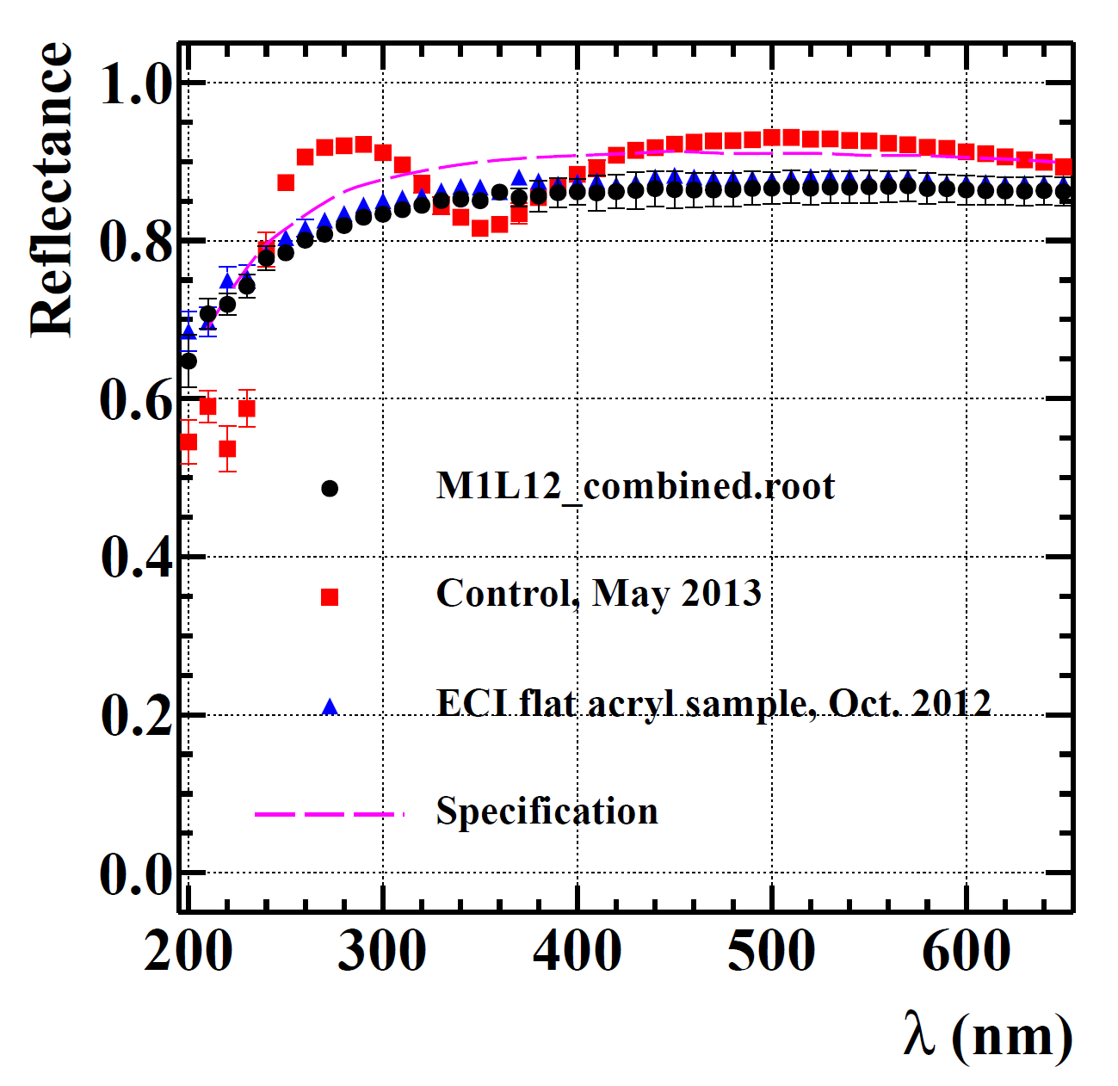
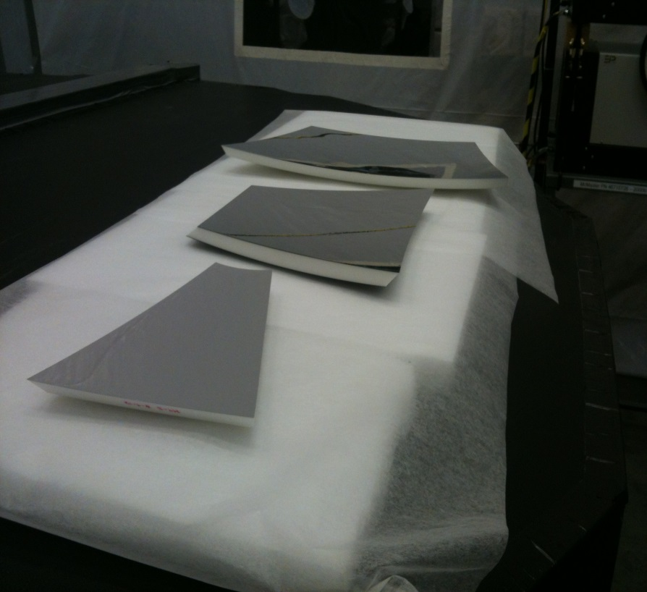
Coating and Reflectance Tests
o Free of visible defects
o Test results acceptable and consistent with flat
sample results used to award contract to ECI

Slide 15
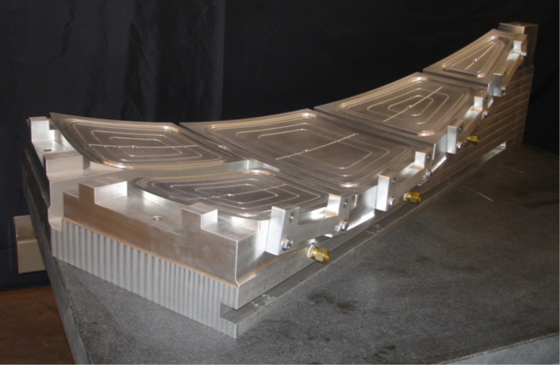
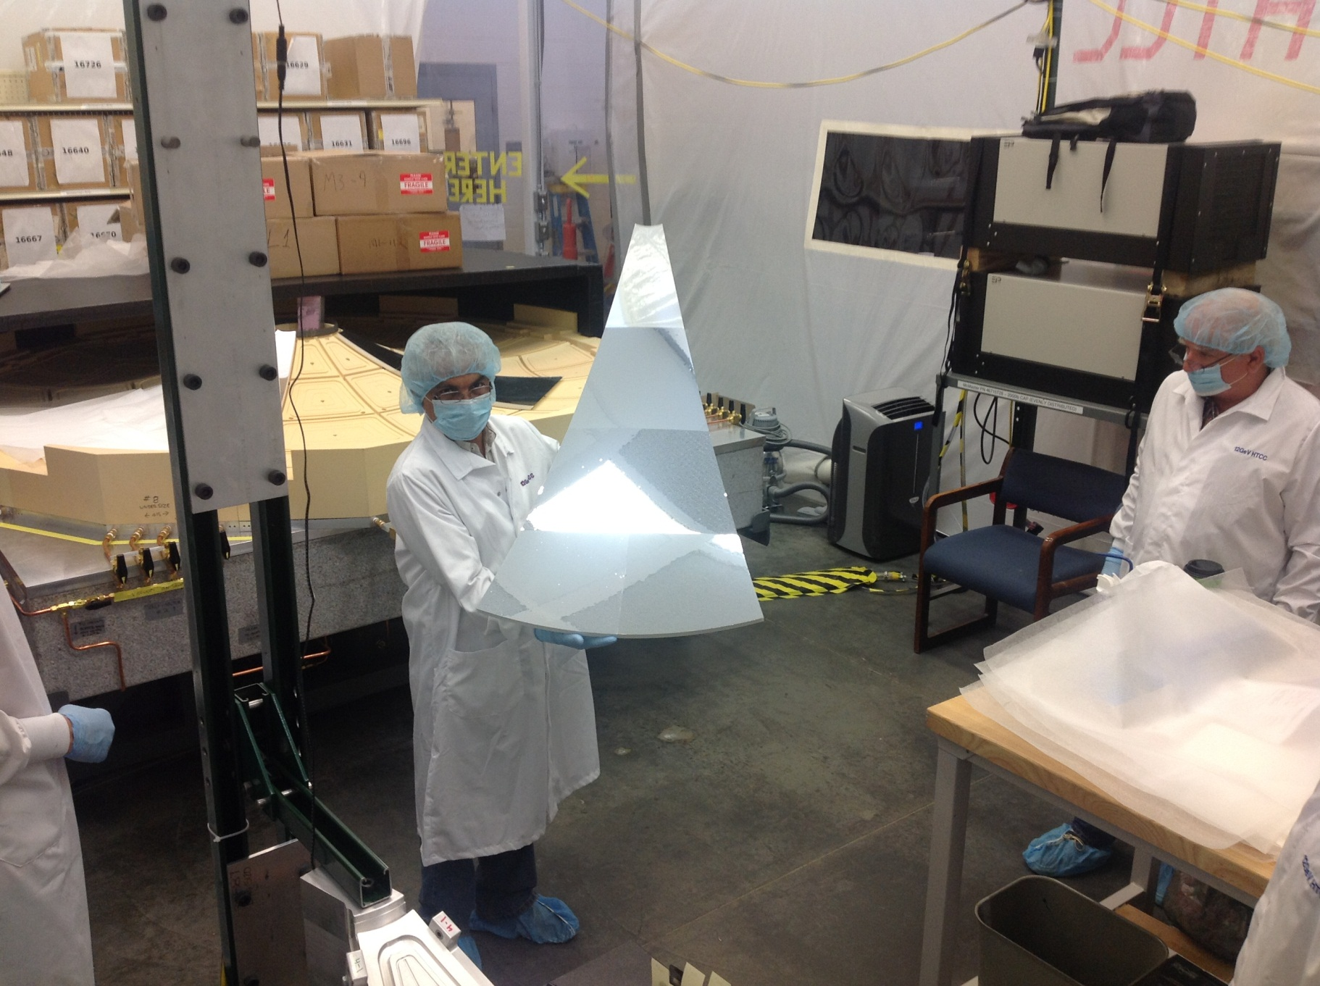
Assembly of the HTCC Half-sector Mirrors
- Epoxy glue of high viscosity and small
shrinkage was applied to one side only
covering ~25% of contact area.
- Geometry was tested before and after
facets were glued together.
- Environment in the HTCC Clean
Room was RH=36%, T=79.8⁰F.
- Assembly steps are illustrated in
pictures bellow.
High Precision Base for single
Half Sector assembly
#4
#3
#2
#1Right
#1Left

Slide 16
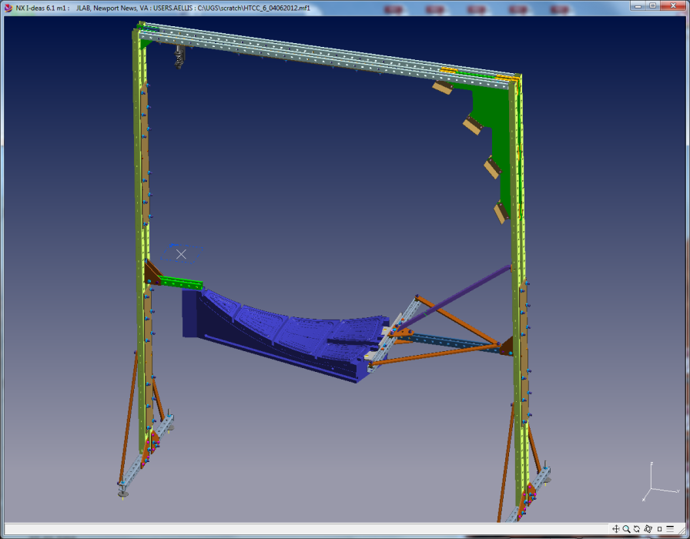
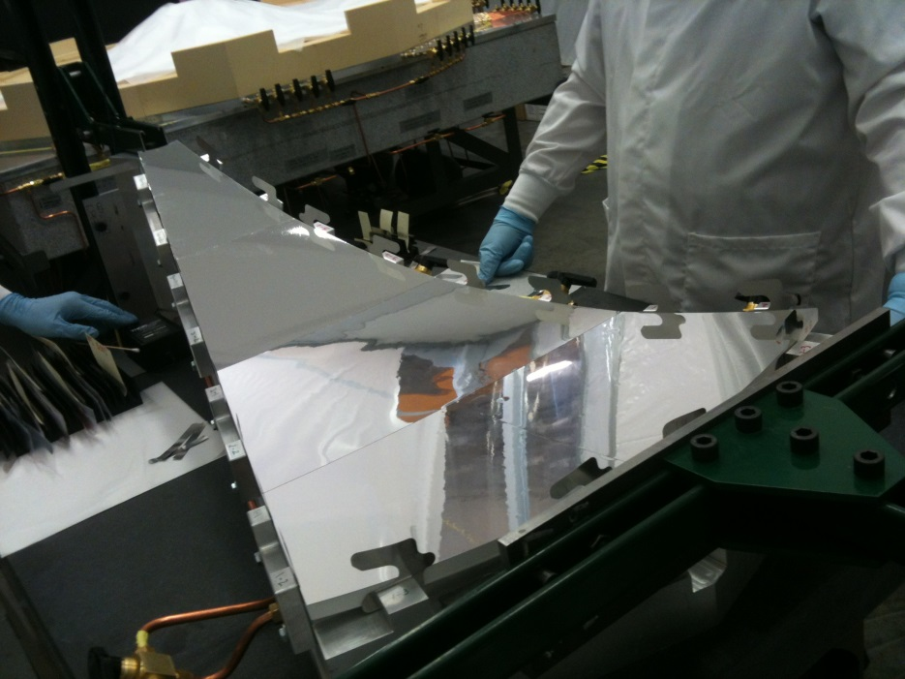
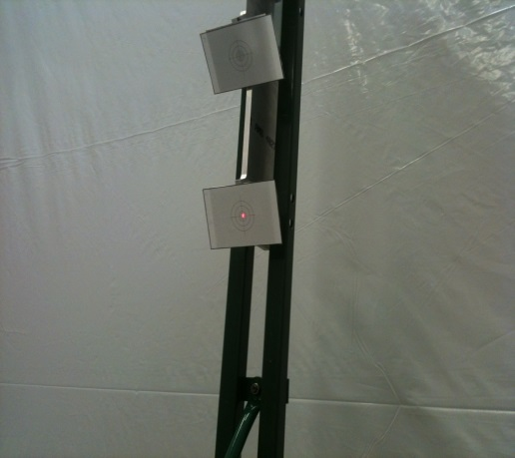
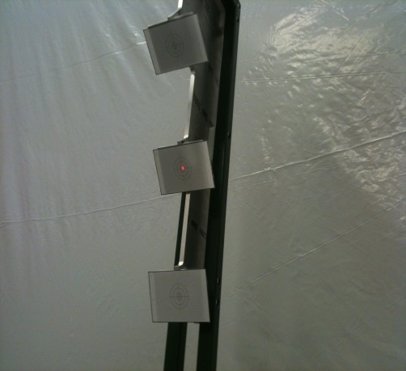
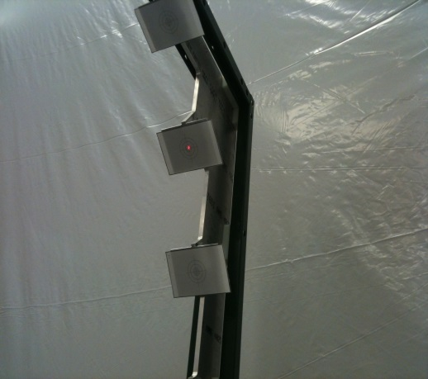
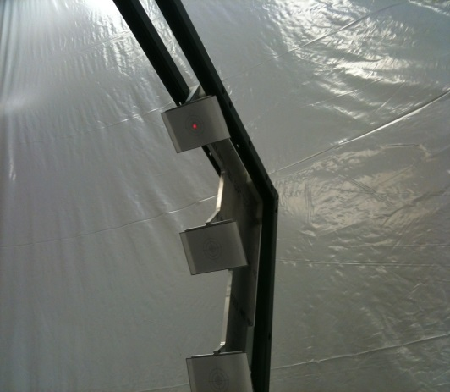
Geometry checked with Laser beam rasterized off the center line of Half-sector Mirror
Adjustable Laser mount
Focal Planes

Slide 17
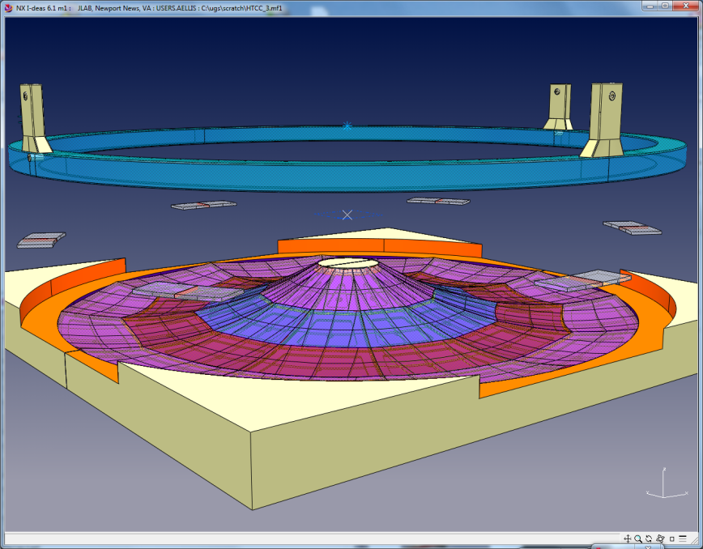
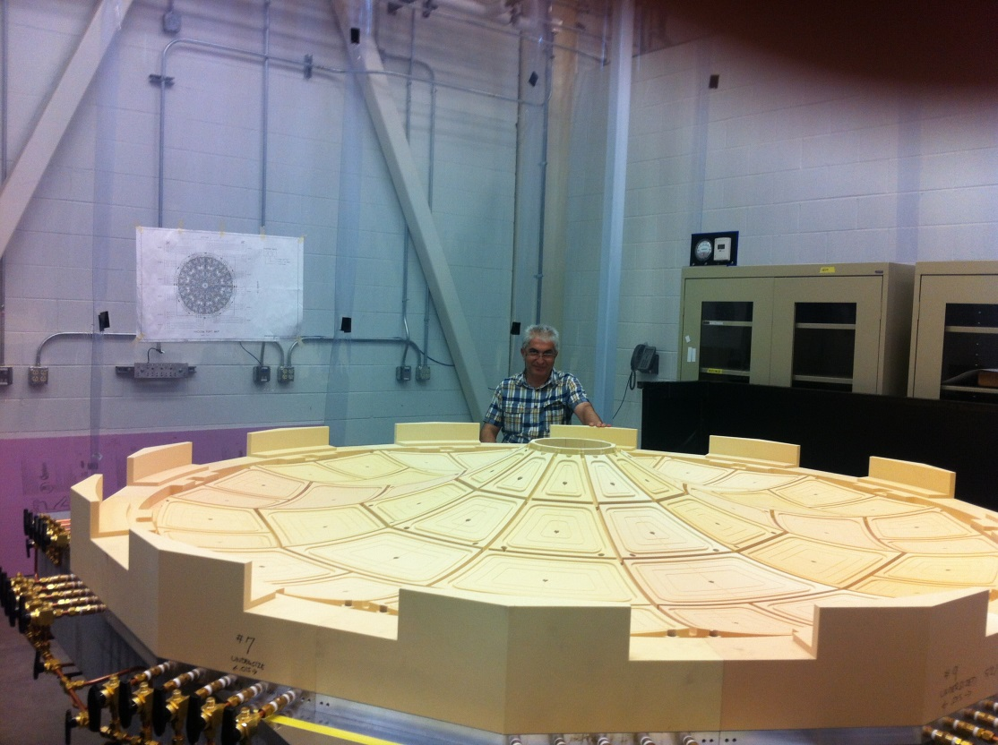
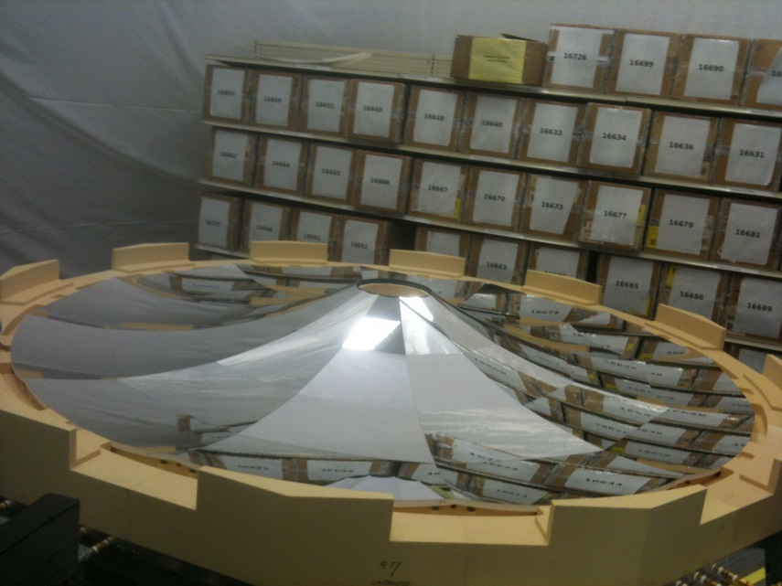
Combined Mirror Assembly
Combined Mirror Assembly Jig
Combined Mirror Assembly Jig
OD=8ft.
Combined Mirror Assembly Jig allows:
Step-by-step assembly of the Combined Mirror by adding
one Half Sector Mirror at the time and start gluing
Process after all 12 Half Sectors aligned
Vacuum retention of the Half Sectors (1 to 12 in any
combination) for extended period of time

Slide 18
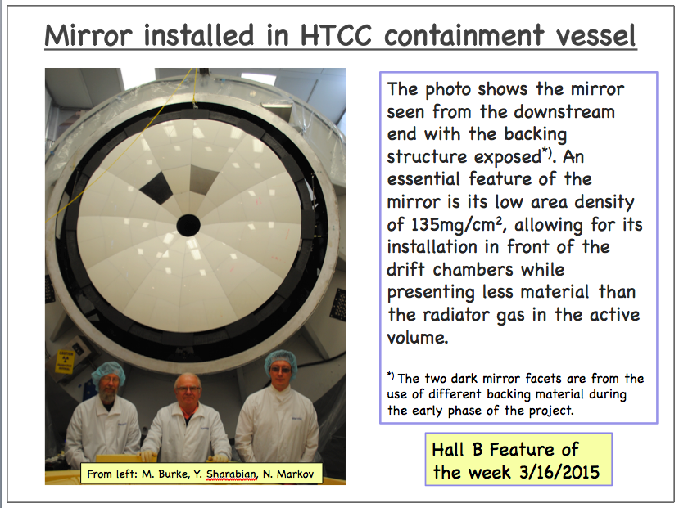
Mirror installed in HTCC

Slide 19
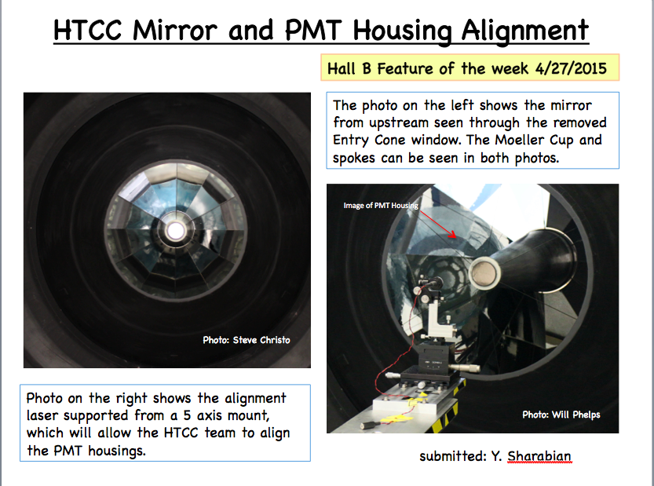
PMT Alignment

Slide 20
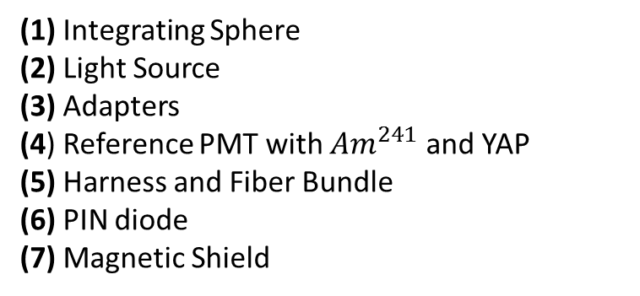
HTCC Light Monitor System (LMS)
Fast Checking the detector operation
Monitoring gain of all HTCC channels
Calibration each channels
1
6
2
3
(1) Integrating Sphere
(2) Light Source
(3) Adapters
(4) Reference PMT with ${Am}^{241}$ and YAP
(5) Harness and Fiber Bundle
(6) PIN diode
(7) Magnetic Shield
5
4
7

Slide 21
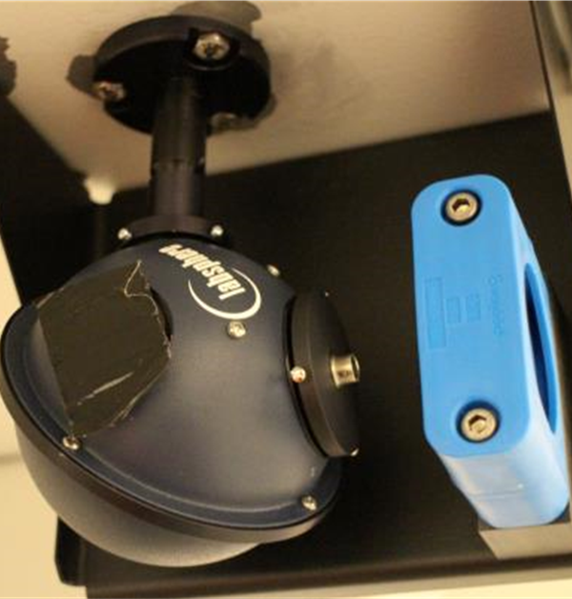
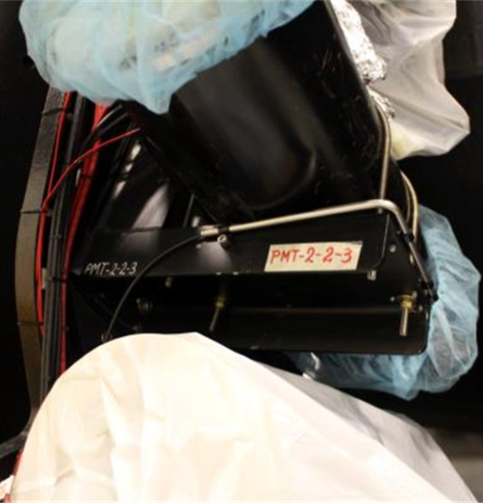
HTCC Light Monitor System

Slide 22
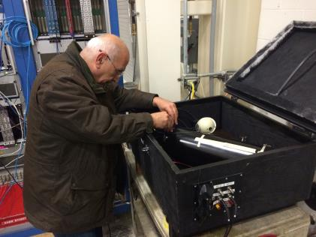
Test Setup
Test purpose
PMT base (HV Divider + Amplifier)
PMT Gain Matching
Light source (LED + driver)
Fiber Bundle
Dark Box

Slide 23
Test Setup
HV Power Supply
Integrating Sphere
LED Driver
LED
PMT
Discriminator
fADC250
Function Generator
CODA

Slide 24
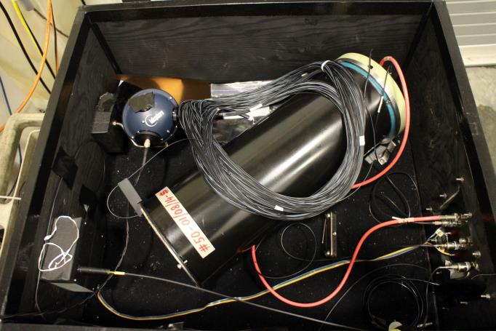
Test Setup
Integrating Sphere
LED Driver
LED
PMT

Slide 25
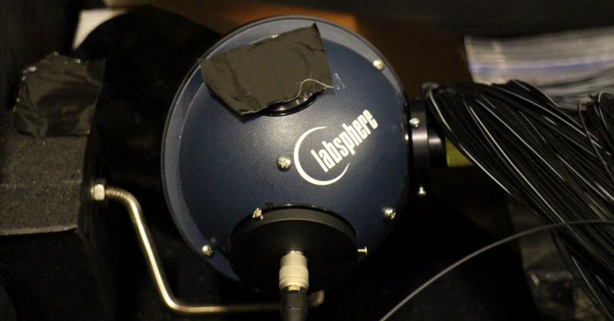
Integrating Sphere
Integrating Sphere

Slide 26
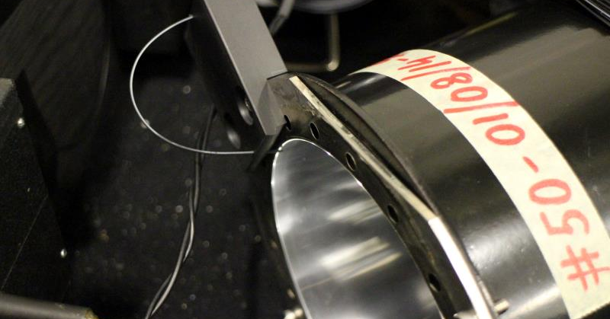
Test Setup
Winston Cone with Fiber

Slide 27
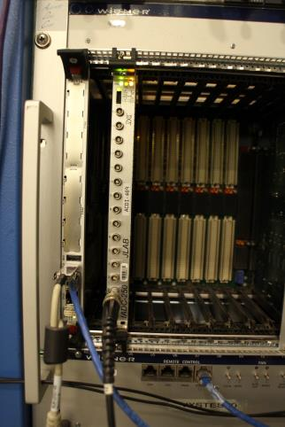
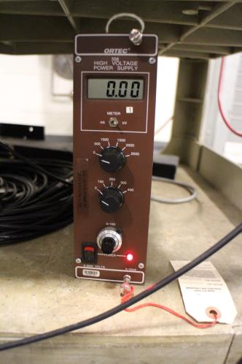
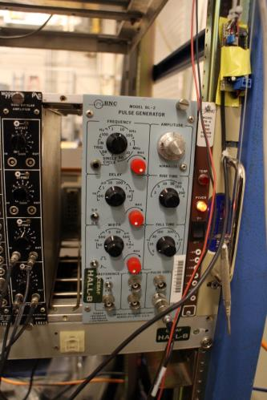
Test Setup
Electronics Setup

Slide 28
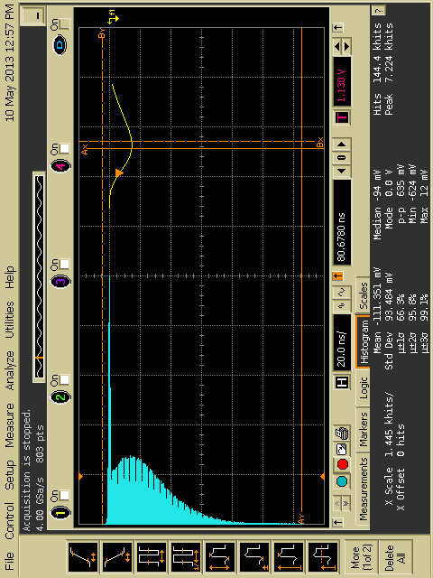
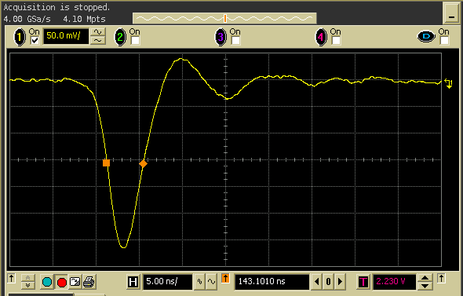
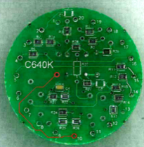
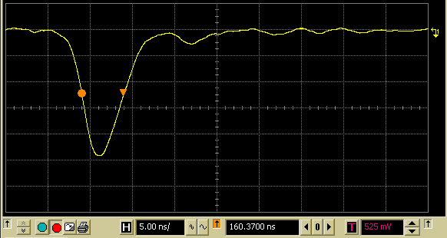
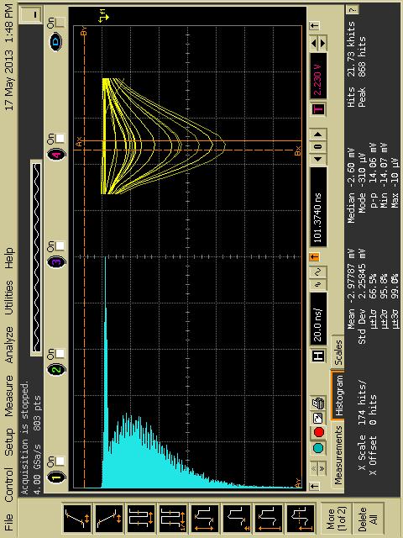
PMT base (HV Divider + Amplifier)
ET base, external amplifier HV=2.2kV
No positive bump on the tail
Leading edge 2.6ns 3.8ns
FWHM 5.4ns 8.0ns
Total width 10ns 20ns
Output range 2.5V 3V on each output
Outputs number 1 2
Modified active base at HV=1.6kV

Slide 29
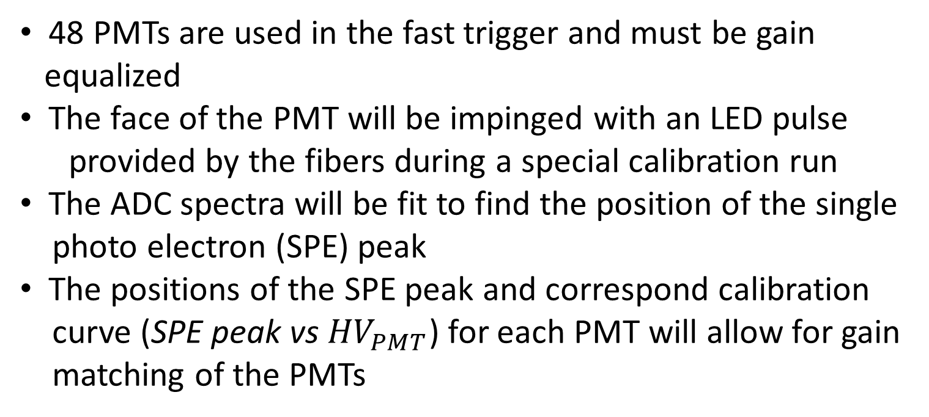
PMT Gain Matching
48 PMTs are used in the fast trigger and must be gain
equalized
The face of the PMT will be impinged with an LED pulse
provided by the fibers during a special calibration run
The ADC spectra will be fit to find the position of the single
photo electron (SPE) peak
The positions of the SPE peak and correspond calibration
curve (SPE peak vs ${HV}_{PMT}$) for each PMT will allow for gain
matching of the PMTs

Slide 30


A Model of PMT response
Operation for a PMT
Photo conversion and
electron collection
Amplification
Amplification
P(n; μ ) = $\frac{μ^{n}e^{−μ}}{n!}$ $μ$ = mq is a mean number of photoelectrons collected by the first dynode
$G_{1}$(x) = $\frac{1}{σ_{1}\sqrt{2π}}exp⁡(− \frac{{\left(x−Q_{1}\right)}^{2}}{2{σ_{1}}^{2}} )$
$G_{n}$(x) = $\frac{1}{σ_{1}\sqrt{2πn}}exp⁡(− \frac{{\left(x−{nQ}_{1}\right)}^{2}}{2n{σ_{1}}^{2}} )$
$S_{ideal}(x)$ = P(n; $μ$)$⨂G_{n}(x)$= $\sum_{n=0}^{∞}{\frac{μ^{n} e^{−μ}}{n!} \frac{1}{σ_{1}\sqrt{2πn}} exp⁡(−\frac{{(x−nQ_{1}^{})}^{2}}{2n{σ_{1}}^{2}}}$

Slide 31

A Model of PMT response
Background processes
The low charge processes:
the leakage current, external and internal radioactivity, etc.
The discrete processes :
thermoemission, noise initiated
by the measured light, etc.
B(x)$= \frac{(1−w)}{σ_{0}\sqrt{2π}}\exp\left(− \frac{x^{2}}{2{σ_{0}}^{2}}\right) + wθ\left(x\right)α exp⁡(−αx)$
$$S_{real}\left(x\right)= \int{S_{ideal}\left(x^{′}\right) B\left(x−x^{′}\right)dx^{′}= \sum_{n=0}^{∞}{\frac{μ^{n}e^{−μ}}{n!} [\left(1−w\right)G_{n}\left(x−Q_{0}\right)+wI_{G_{n}⨂E}(x−Q_{0})}}$$
$I_{G_{n}⨂E}\left(x−Q_{0}\right)$ = $\int_{Q_{0}}^{x}{G_{n}(x^{′}−Q_{0})αexp⁡[−α\left(x−x^{′}\right)dx′}=\frac{α}{2}exp⁡[−α$(x-$Q_{n}−α{σ^{2}}_{n}^{})]×$
erf($\frac{|Q_{0}−Q_{n}−α{σ²}_{n}^{}|}{σ_{n}\sqrt{2}})+sign(x−Q_{n}−α{σ^{2}}_{n}^{})×erf⁡(\frac{|x−Q_{n}−α{σ^{2}}_{n}^{}|}{σ_{n}\sqrt{2}}$)]
$Q_{n}=Q_{0}+nQ_{1}, σ_{n}≈\sqrt{σ_{0}²+nσ_{1}²}$ $≈\left\{\begin{aligned}σ_{0} n=0 \\ \sqrt{n}σ_{1} n>0\end{aligned}\right.$

Slide 32








Fit Results

Slide 33

Pavel Fit

Slide 34


HV test
Fitting the position of the SPE peak as function of high voltage we can equalize all channels

Slide 35




Intensity Test
PMT HV =1600V
Shows the range of µ, and what range the LED driver can cover
This test will be repeated with µ ranging from .3-1.0

Slide 36

Intensity Test
• Gain of the PMT held
constant
• Good results with
Varying light intensities
Fit results compared
With other algorithms

Slide 37

Finding the Calibration Curve
• Gain of the PMT
measured with fit
• Each PMT will have it’s
own gain curve
• Fit results also
compare with other
algorithms

Slide 38

Fiber Bundle Test
μ
All 50 fibers produced a signals
Intensity is uniform ± 3%

